Slide 1

Detection Of Network Anomalies In Smart Home Internet Of Things In Machine Learning
Program Name: Masters of Science (Data Science)
Subject Name: Project 1 (MCST1043)
Student Name: Guo Yachao
Metric number: MCS241039

Slide 2
Introduction
The Internet of Things provides us with daily convenience. Smart home connects various devices in the home through the Internet of things network to form an intelligent and automated home ecosystem.

Slide 3
TABLE OF CONTENTS
Background Study
Data Collection
Researcher Question and Objective
Literature Review
Problem Statement
Data Cleaning Process
Descriptive Analysis
Scope of Study
Initial Finding & Result
Summary
Research Methodology

Slide 4
Background Study
The popularity and complexity of smart home internet of things:
Threats to network anomalies:
Hostile attack : distributed denial of service attacks,malware infection.
Equipment trouble : hardware failures or software errors may occur.
Misconfiguration : the user or administrator may have incorrectly configured the
device parameters.
Equipment diversity : a variety of devices produced by different manufacturers and operating systems.
Data traffic is surging : generate a lot of data streams.
Resource constraints : low computing power and storage capacity, which makes it difficult to run traditional security protection software.

Slide 5
Problem Statement
Limitations of traditional methods:
Advantages of machine learning:
high false positive rate:traditional methods tend to misinterpret normal behavior as abnormal
lack of intelligence:traditional methods are difficult to deal with large-scale, heterogeneous device data
high efficiency:machine learning can handle large-scale, high-dimensional data streams
real-time:machine learning algorithms can achieve efficient real-time detection in the smart home environment
adaptability:machine learning can process large-scale, high-dimensional data streams

Slide 6
Research Questions & Objectives
Research Questions:
Research Objective:
Which data sets can be more representative and widely used as experimental materials?
Which machine learning methods are selecte？
How to evaluate the various performance of machine learning? What methods are used to compare them?
Machine learning based on a smart home anomaly detection method is used to detect abnormal and normal behavior of Internet of Things device traffic, thereby identifying malicious activities on the network, including external attacks and attempts.

Slide 7
Scope of Study
01
Data collection
02
Explore Data Analysis
03
Machine selection
04
Analysis of results
Which data sets can be more representative and widely used as experimental materials
What parts of the data set are visualized
Select which machine learning models to use
How to evaluate the model

Slide 8
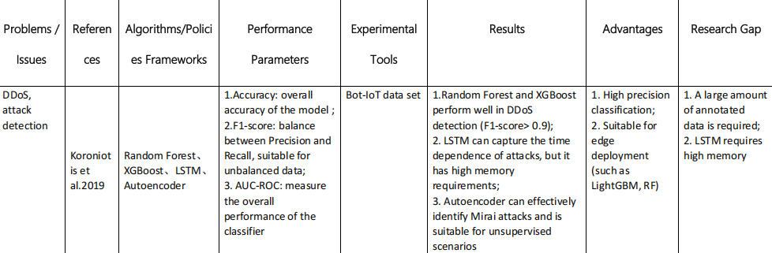
Literature Review
Data analysis：
Check the source and content of the data set

Slide 9
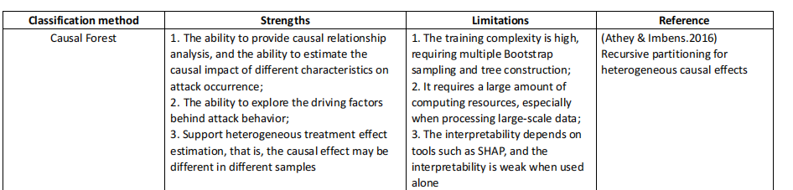
Literature Review
Machine learning：
Check out which machine learning can be used for this study

Slide 10
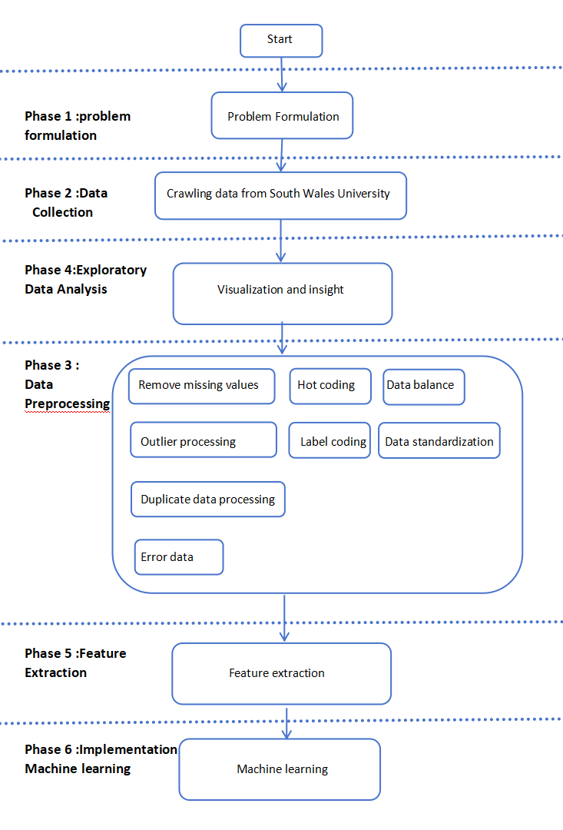
This research framework include the following steps
Research Methodology
1.Problem Definition
2.Data Collection: Crawling data from University of New South Wales
3.Data Pre-processing: Cleaning and preparing data for further analysis.
4.Feature Extraction: Applying stemming and
vectorization techniques.
5.Model Build: Using machine learning models (Logistic Regression,SVM and Naive Bayes).
6. Model Evaluation: Compares model performance using evaluation matrices.

Slide 11
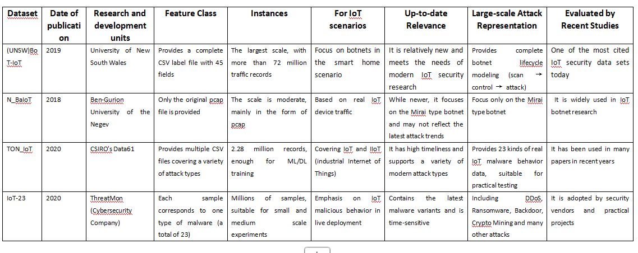
Data Collection Method
Select the most appropriate data set for this project : (UNSW)BoT-IoT

Slide 12
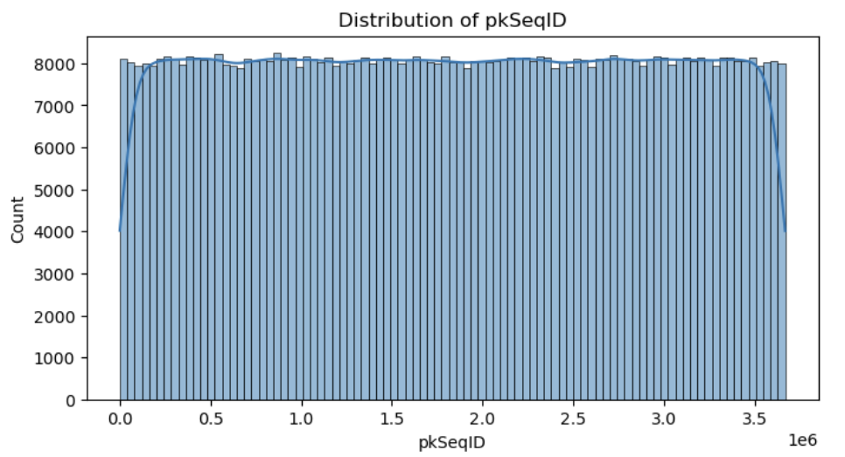
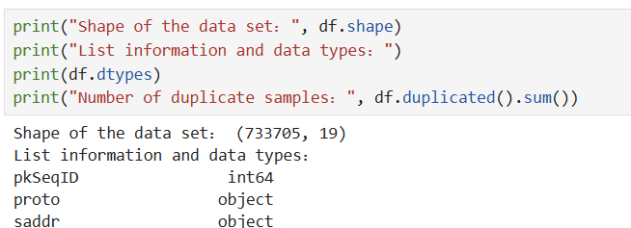
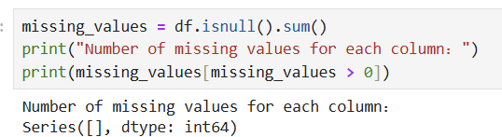
Explore Data Analysis
Shape of the data set, data type (whether the data needs to be transformed)
Repeat and missing data set (whether to delete)
Data set eigenvalues, and the number of eigenvalues

Slide 13
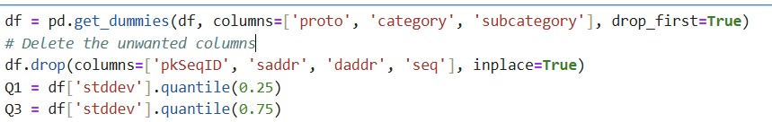
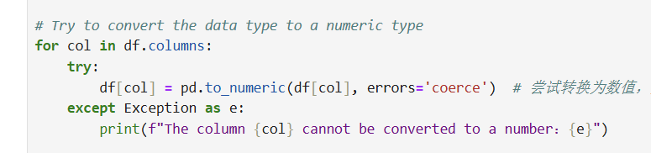
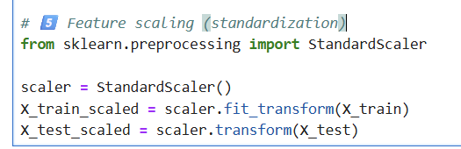
Data preprocession
Data cleaning：
Remove irrelevant fields and process missing values
Data type conversion：
Perform unique heat coding for the classification features
The label coding technique is used to transform the feature vector
Data standardization/normalization：
After data standardization/normalization, it helps to improve the efficiency of machine processing

Slide 14
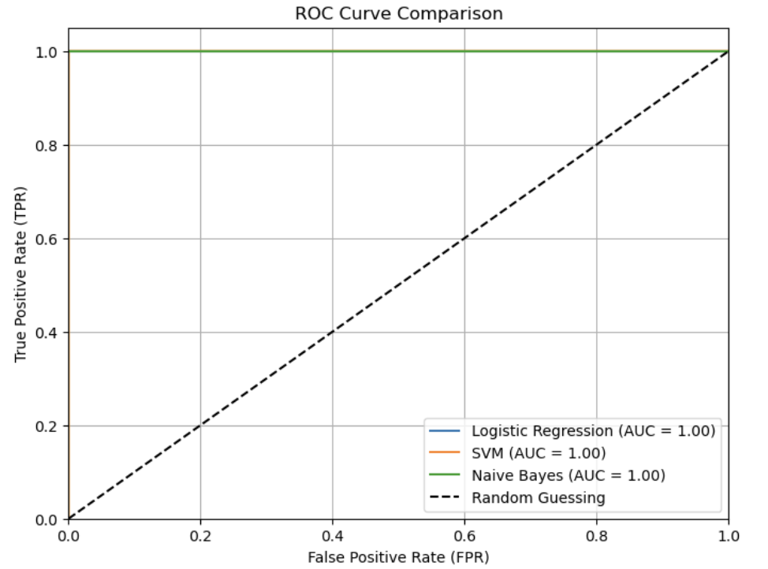
Initial Finding & Result
Experimental Result ：Accuracy、 Precision、 Recall、F1-Score
ROC Curve Comparison（the relationship between the true example rate and the false positive example rate of the model is shown to help us understand the performance of the model at different thresholds）： Naive Bayes、 Logistic Regression

Slide 15
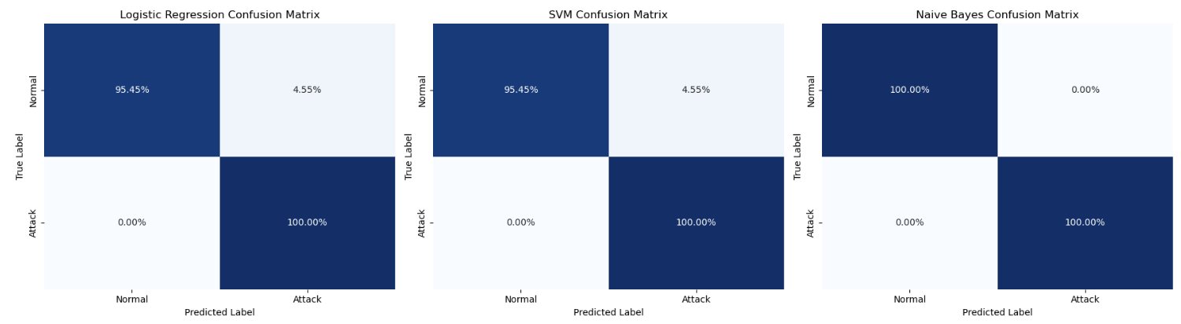
Initial Finding & Result
Confusion Matrix（the performance of the model in a binary classification task, that is, to evaluate the prediction accuracy of the model）： Naive Bayes

Slide 16
Summary
In the detection of smart home anomalies, the naive Bayes algorithm is better than the other two in detecting abnormal and normal behaviors of Internet of Things device traffic.

Slide 17
Thank You

